Slide 1
Presentation title goes here
Speaker name
Title
Microsoft IT

Slide 2
Presentation title goes here
Speaker Name
Title
Microsoft IT

Slide 3
Presentation title goes here
Speaker Name
Title
Microsoft IT

Slide 4
Presentation title goes here
Speaker Name
Title
Microsoft IT

Slide 5
Presentation title goes here
Speaker Name
Title
Microsoft IT

Slide 6
Presentation title goes here
Speaker Name
Title
Microsoft IT

Slide 7
Open authoring: Content collaboration across disciplines
Ralph Squillace
Senior (means “old”) Content Engineer (What?)
Microsoft Cloud + Enterprise (must be large)

Slide 8
Key takeaways
Collaboration across disciplines drives customer satisfaction
Open authoring strategies and tools that allow active collaboration across engineering, consulting, architecture, and support teams
Challenges of open authoring and cross-discipline content accountability
Best practices for sustainable collaboration

Slide 9
Kliff’s™ Notz™ Bullets slide
our work to date
tools and best practices that are evolving to allow for collaboration
some of our plans for the future
lessons learned.

Slide 10
Preferred text layout (no bullets)
Main topic 1: size 40pt
Size 20pt for the subtopics
Size 20pt for the subtopics
Main topic 2: size 40pt
Size 20pt for the subtopics
Size 20pt for the subtopics
Main topic 3: size 40pt
Size 20pt for the subtopics
Size 20pt for the subtopics

Slide 11
Where I’m going today…
2:00pm-2:45pm DocOps — The Analytical Window to Your Customer’s Experience: Donner (1st floor)
2:00pm-2:45pm Boost Your Content Strategy for REST APIs: Cascade Room (1st floor)
Size 20pt for the subtopics
Size 20pt for the subtopics
Size 20pt for the subtopics
Size 20pt for the subtopics
Size 20pt for the subtopics

Slide 12
Bullet points layout with subtitle Subtitle
Example of a bulleted slide with a subhead
Set the slide title to “Sentence case”
Set subheads to “Sentence case”
Hyperlink style
www.microsoft.com

Slide 13
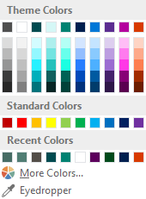

Slide palette info
The PowerPoint palette for this template has been built for you and is shown below. Avoid using too many colors in your presentation.
Accent colors 1-6 – (6 Theme Colors to the far right)
Accent 1
Accent 2
Accent 3
Accent 4
Accent 5
Accent 6
Use Accent 1 as the main accent color. Use Accent 2 and Accent 3 when additional colors are needed.
Use Accents 4-6 sparingly – only when more colors are necessary.

Slide 14
Work to date
Let’s catch up to that crusty old Microsoft corporation….

Slide 15
When we last left our hero…
It was publishing developer content on MSDN/Technet
Custom XML authoring environment based on Word™®©
Collaboration was in Word revisions and sharepoint and… hindered. (I believe “vetus-schola” is the Latin term…)
Releasing typically every three months…
Conversion from XML to HTML was massive undertaking….
Size 20pt for the subtopics
Pipeline was custom software
Expensive to build
More expensive to maintain
Per Dilbert specifications, it was out of date prior to release.

Slide 16
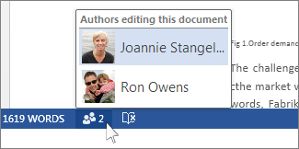
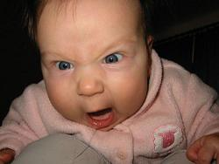
It was great for a lot of work…Really!
But as the number of reviewers and articles grew, eventually…

Slide 17
Not one system was built to handle the speed or scale of what we would become
Standard systems issue:

Slide 18
Digression: The explosion of words
Community-written software demonstrated quality and scale
Speed of features increased radically
Huge new audiences sizes (Windows, Linux, Android, Mac, iOS)

Slide 19
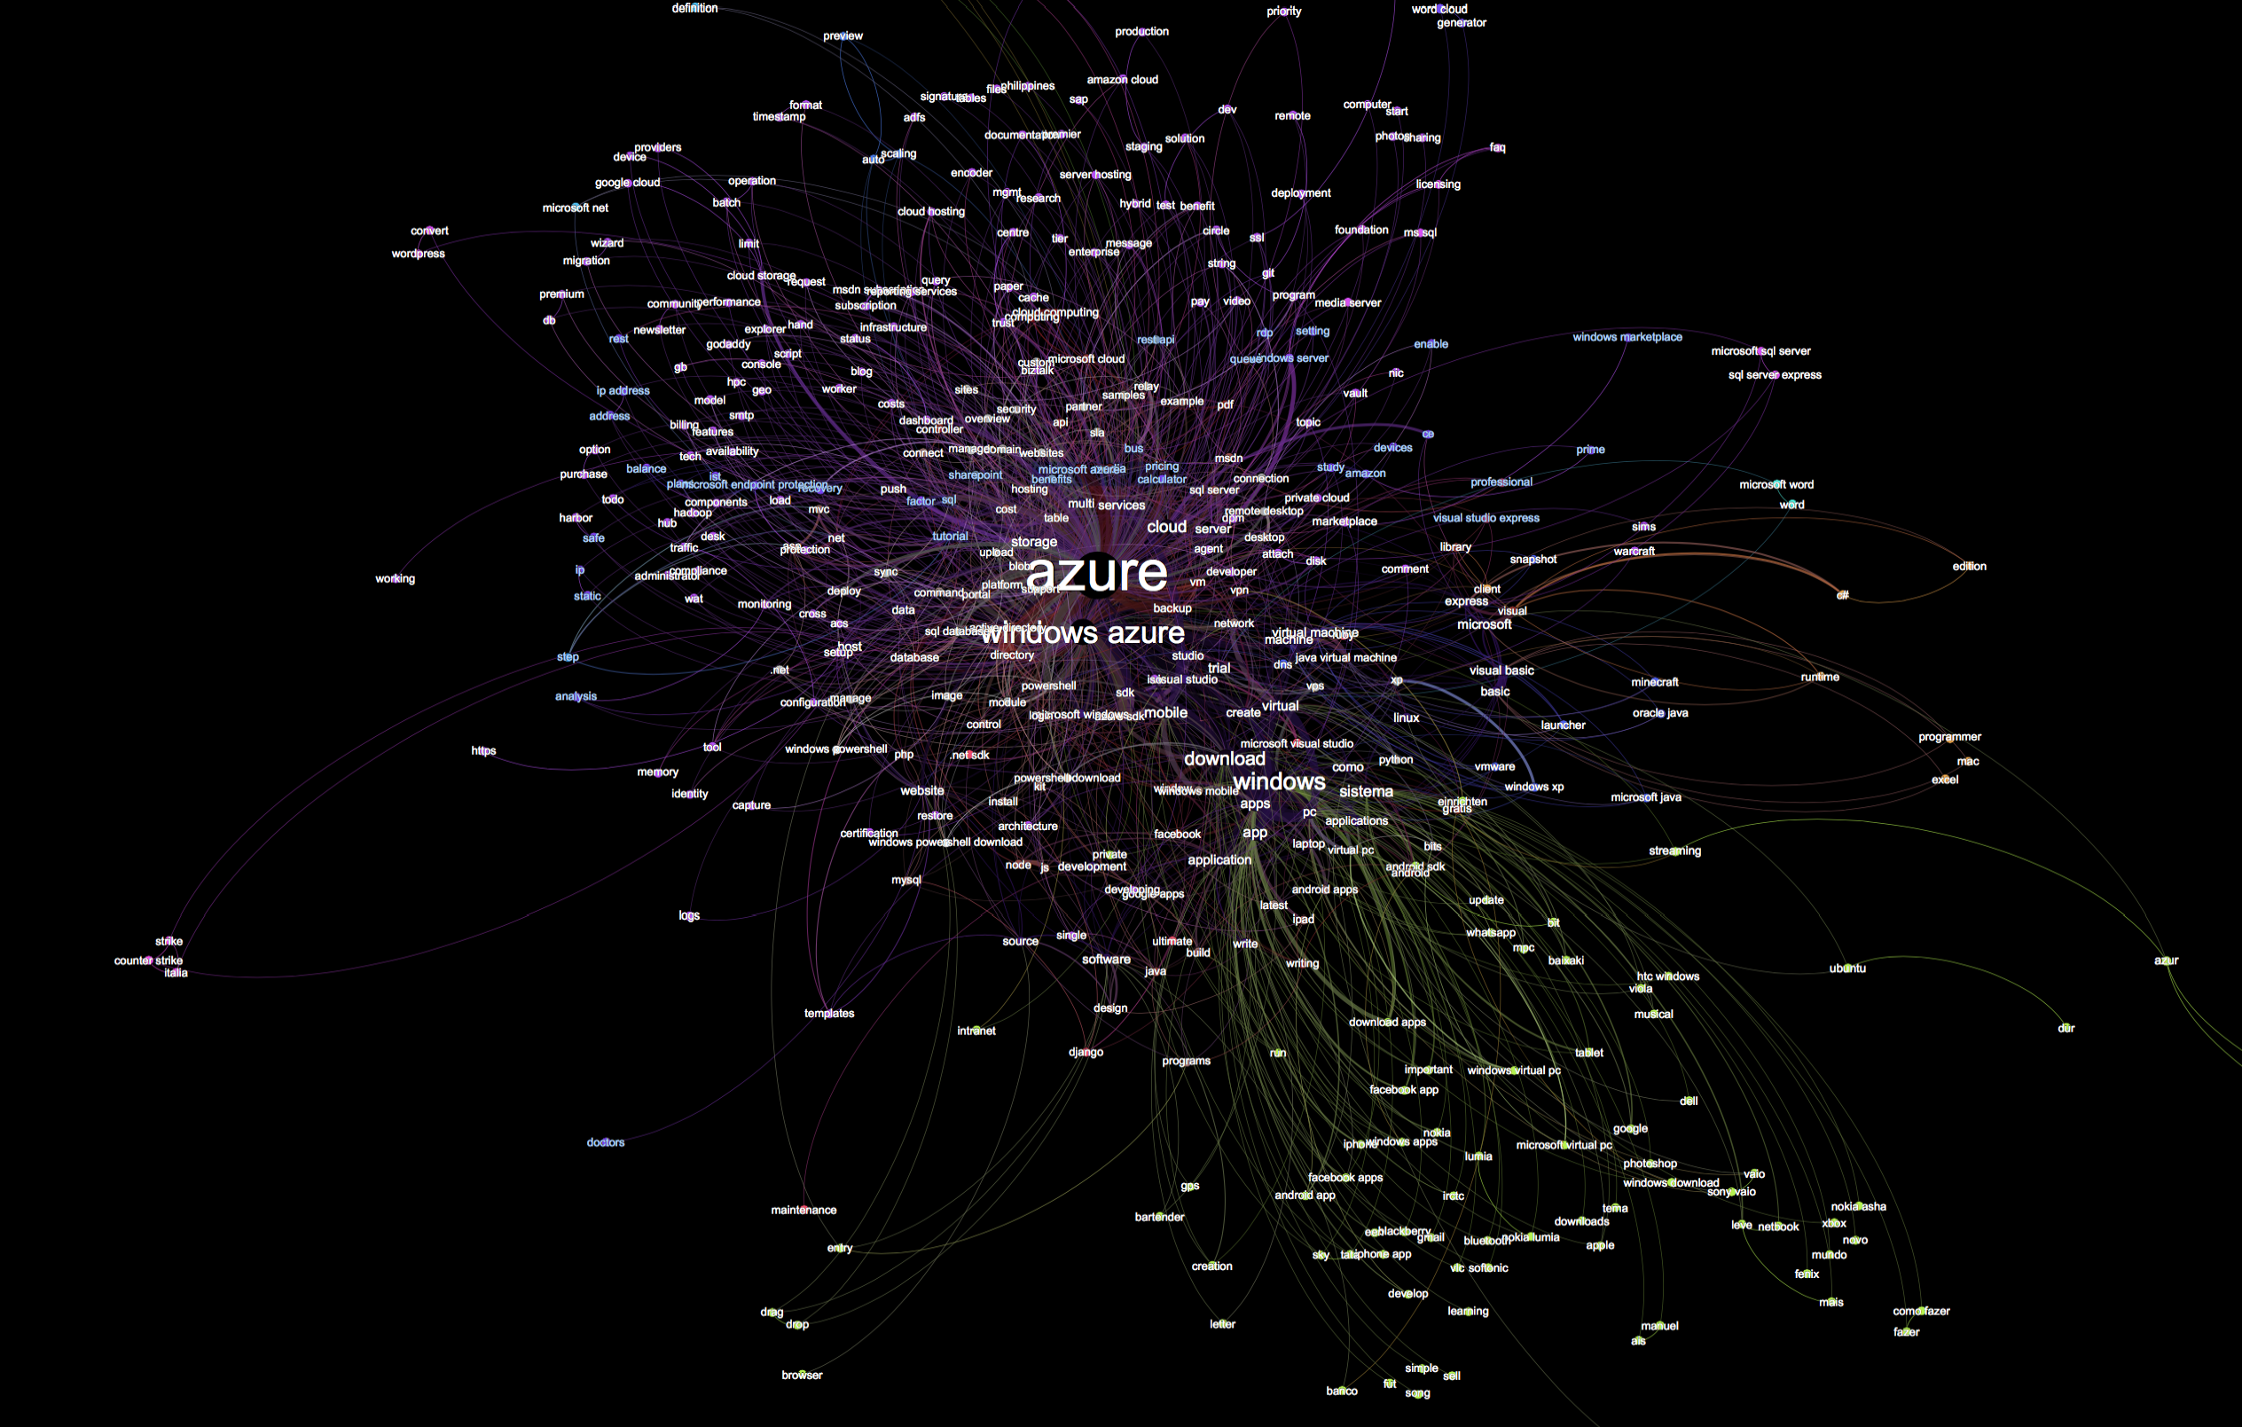

Slide 20
Tools and Best Practies

Slide 21
Where we are
https://azure.com
Opensource:
Two repositories on https://github.com: public is https://github.com/azure/azure-content.
File format is markdown, with custom extensions for reuse, standardized javascript, and other special features.
Nothing in the entire toolchain is Windows-only
Authoring in anything that writes markdown.
Main topic 3: size 40pt
Size 20pt for the subtopics
Size 20pt for the subtopics

Slide 22
Who’s committing…
Of course, with dupicates and new accounts, it’s really on the order of about 900 contributions, in a normal distribution, as you’d expect….
3966 Sebastian Durandeu 2830 Molly Bostic 2105 v-aljenk 1891 Dene Hager 1739 Jim Becker 1621 Tyson Nevil 1527 Ross McAllister 1279 C.J. Gronlund 961 unknown 751 ggailey777 741 Ty 678 Tom Dykstra 673 Larry Franks 668 Sreedhar Pelluru 570 David Wrede 524 Jemash 512 Monica Rush 431 SharS 418 Glenn Gailey 416 Andy Pasic 387 pennij 383 Tom FitzMacken 360 CherylMc 351 Matt LaBelle 316 Ralph Squillace 312 Carolyn Gronlund 305 Kathy Davies 286 ShawnJackson 284 Bryan Lamos 279 Juliako 276 Walter Poupore (Microsoft) 273 Joao Madureira 272 jimbe 271 davidwrede 271 Tamra Myers 269 Alan Cameron Wills 265 cherylmc 264 Brian Swan 257 Jonathan Gao 242 Gary Ericson 236 HeidiSteen 236 Bill Mathers 235 Seth Manheim 230 Steve Stein 228 Andy (adegeo) 226 Jeff Stokes 224 Alpa Kohli 221 Dan Lepow 217 tysonn 217 Steve Danielson 217 Ryan Wike 209 Katie Griffith 207 Blackmist 206 Penni Johnson 190 v-kagri 188 cephalin 186 Matthew Henderson 185 Alma Jenks 183 deneha 182 Curtis Love 177 mimig 168 Sigrid Elenga 160 bradsev 157 pcw3187 157 Dhanashri Kshirsagar 155 Tom Archer 155 RickSaling 149 Jim-Parker 146 barbkess 144 Joost de Nijs 142 Patrick Sheahan 139 krisragh 139 Erik Reitan 138 sidneyh 136 ghogen 135 mattshel 135 GeneMi-MightyPen 131 jeffstokes72 130 Donna Malayeri 128 curtand 125 Bill Anderson 122 Telmo Sampaio 120 tfitzmac 119 Mimi Xu 117 Brian Wren 115 v-lincan 113 Stephen Siciliano 111 jessebenson 110 Ken Hoff 109 Christopher Anderson 108 Liza Poggemeyer 106 Jason Roth…..

Slide 23
Future plans

Slide 24
Lessons known; lessons learned

Slide 25
DRAGONS: Markdown is not structured.
Implications:
Rebuilt
Size 20pt for the subtopics
Size 20pt for the subtopics
Main topic 3: size 40pt
Size 20pt for the subtopics
Size 20pt for the subtopics

Slide 26
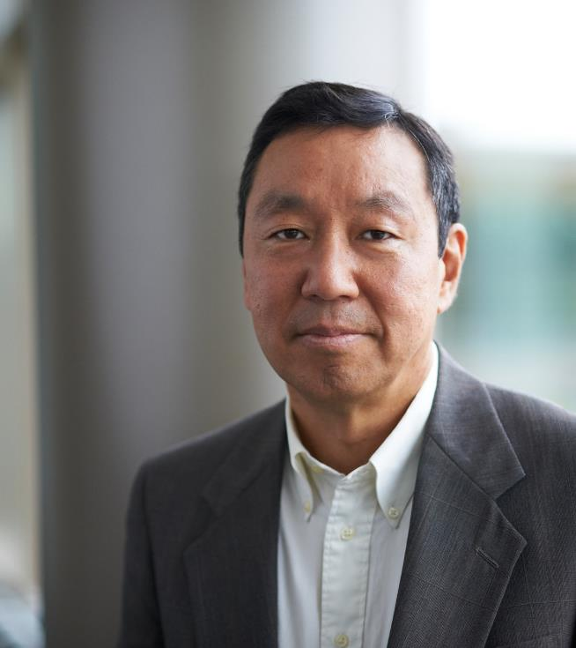
Photo layout 1

Slide 27
Software code slide
This slide layout uses Consolas, a monotype font which is ideal for showing software code.

Slide 28
Notes (hidden)
Some speakers at Microsoft like to use this slide for hidden “notes slides”.
Delete it if you don’t want to use it.
NEXT: <next slide title>

